Slide 2

OpenTURNS use for reliability assessments FORM/SORM, classical simulation methods

Slide 3
Some classical simulation (sampling) methods
Monte Carlo: universal method but not practicable for rare event probabilities (high reliability)
Estimating P_{f} = 10^{-k} requires 10^{k+2} simulations with Crude Monte Carlo for a satisfying accuracy (cv = 0.1)
Each run of the G-function (limit state function) may be costly for industrial problems
Development of accelerated simulation methods
Accelerating the convergence, reducing the estimator variance

Slide 4
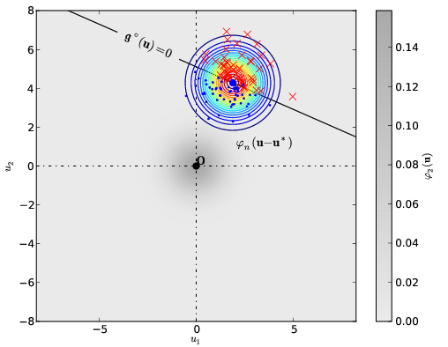
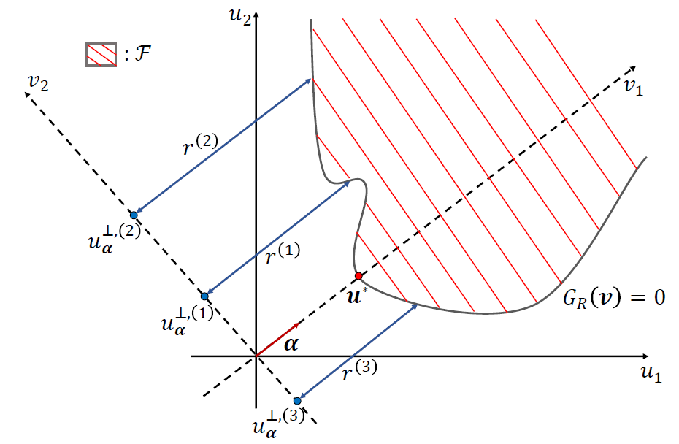
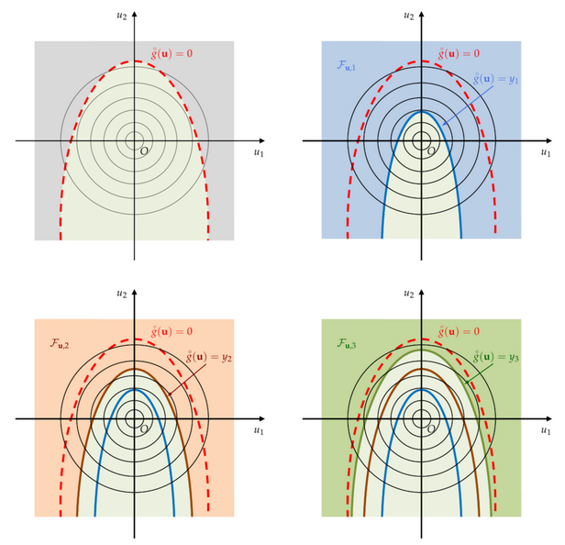





Accelerated simulation methods (classical)
1st group: conditional and directional methods
2nd group: Importance Sampling (most popular)
Concentrating samples in
(around) the failure set
U
2
g(U
,U
) = 0
1
2
P
a
P
aj
i
Most common: FORM-IS
a
a
j
i
U
1
Directional simulation
Averaging
Conditional
Probabilities
3rd group: Subset Simulation
Splitting the space in nested sets
With fixed higher probability (0.1)
Line Sampling

Slide 5
Potential necessity to improve these “basic” accelerated methods
Example: system reliability evaluations (intersections, union of events)
even for a single component
Case of penstock reliability evaluations : time-variant reliability problem → system reliability
{G_{N}(X) > 0} ∩ {G_{N+1}(X) < 0}
→ case of a narrow band
The narrower the band, the slower the convergence of standard FORM-IS
An adaptive strategy starting from standard FORM-IS would be inefficient for narrow bands
→ Proposal of an improved FORM-Importance Sampling method, FORM-IS-NB

Slide 6
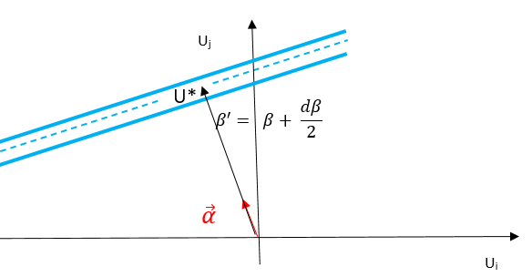


Potential necessity to improve these “basic” accelerated methods
Case of a narrow band - Description
Between the 2 following hyperplanes in the U-space
$\sum_{i=1}^{p}{α_{i}.u_{i}}= β$ (3)
and
$\sum_{i=1}^{p}{α_{i}.u_{i}}= β+dβ$ (4)
P_{f} known exactly
MS 13, Paper 142 - 10th July 2023, Dublin, Ireland

Slide 7
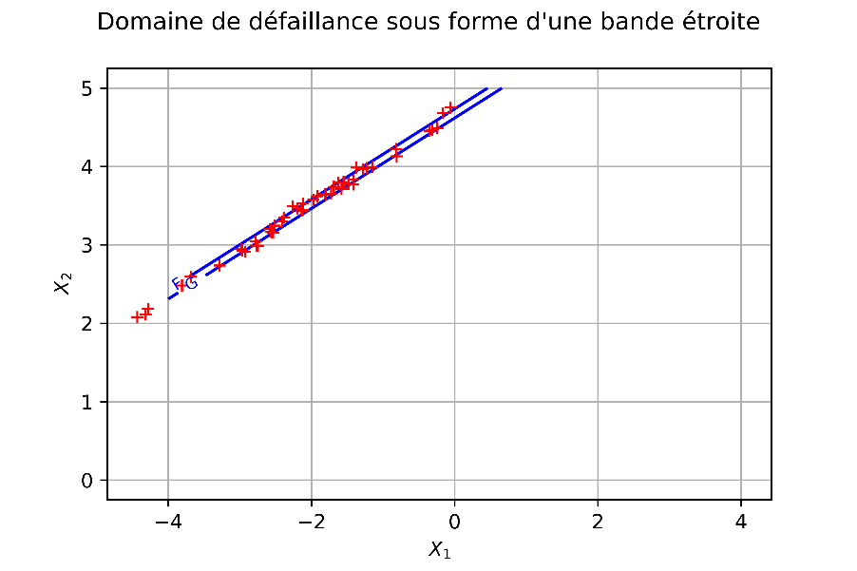
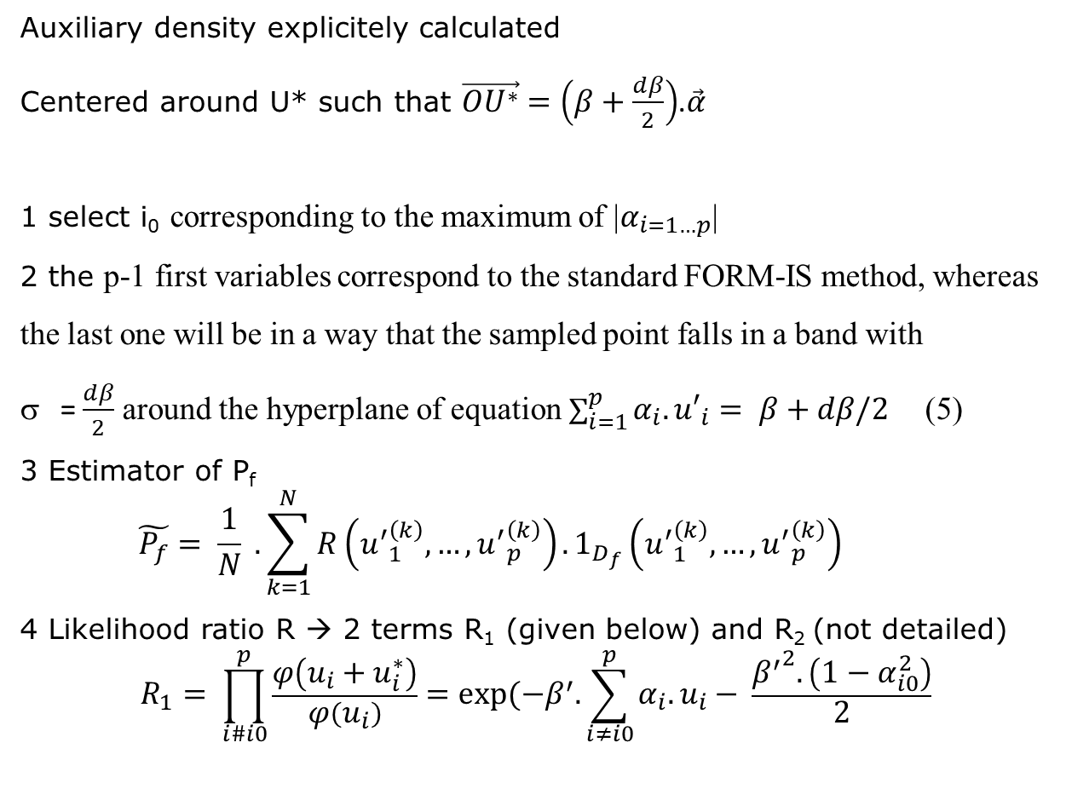
Potential necessity to improve these “basic” accelerated methods
Case of a narrow band – Mathematical treatment
Auxiliary density explicitely calculated
Centered around U* such that $\vec{OU^{∗}}$ $=\left(β+\frac{dβ}{2}\right)$.$\vec{α}$
1 select i₀ corresponding to the maximum of |$α_{i=1…p}$|
2 the p-1 first variables correspond to the standard FORM-IS method, whereas
the last one will be in a way that the sampled point falls in a band with
= $\frac{dβ}{2}$ around the hyperplane of equation $\sum_{i=1}^{p}{α_{i}.{u′}_{i}}= β+dβ/2$ (5)
3 Estimator of P_{f}
$$\tilde{P_{f}}= \frac{1}{N} . \sum_{k=1}^{N}{R\left({u^{′}}_{1}^{\left(k\right)},…,{u^{′}}_{p}^{\left(k\right)}\right). 1_{D_{f}}\left({u^{′}}_{1}^{\left(k\right)},…,{u^{′}}_{p}^{\left(k\right)}\right) }$$
4 Likelihood ratio R → 2 terms R₁ (given below) and R₂ (not detailed)
$$R_{1}= \prod_{i\#i0}^{p}{\frac{φ\left(u_{i}+u_{i}^{∗}\right)}{φ\left(u_{i}\right)}}=exp⁡(−β^{′}.\sum_{i≠i0}^{p}{α_{i}.u_{i}}− \frac{{β^{′}}^{2}.\left(1−α_{i0}^{2}\right)}{2}$$

Slide 8
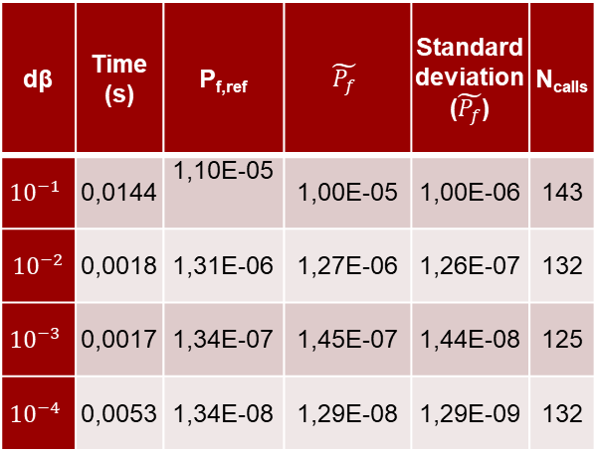
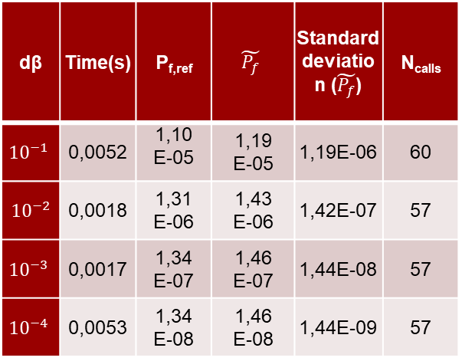
4 Case of a narrow band – Numerical results
Table 1: Number of limit state function calls with the improved FORM-IS
for narrow bands of different widths (p=5)
Table 2: Number of LSF calls with the improved
FORM-IS for narrow bands of different widths (p=10)
dβ | Time(s) | P_{f,ref} | $$\tilde{P_{f}}$$ | Standard deviation ($\tilde{P_{f}}$) | N_{calls}
$${10}^{−1}$$ | 0,0052 | 1,10 E-05 | 1,19 E-05 | 1,19E-06 | 60
$${ 10}^{−2}$$ | 0,0018 | 1,31 E-06 | 1,43 E-06 | 1,42E-07 | 57
$${10}^{−3}$$ | 0,0017 | 1,34 E-07 | 1,46 E-07 | 1,44E-08 | 57
$${10}^{−4}$$ | 0,0053 | 1,34 E-08 | 1,46 E-08 | 1,44E-09 | 57
dβ | Time (s) | P_{f,ref} | $$\tilde{P_{f}}$$ | Standard deviation ($\tilde{P_{f}}$) | N_{calls}
$${10}^{−1}$$ | 0,0144 | 1,10E-05 | 1,00E-05 | 1,00E-06 | 143
$${ 10}^{−2}$$ | 0,0018 | 1,31E-06 | 1,27E-06 | 1,26E-07 | 132
$${10}^{−3}$$ | 0,0017 | 1,34E-07 | 1,45E-07 | 1,44E-08 | 125
$${10}^{−4}$$ | 0,0053 | 1,34E-08 | 1,29E-08 | 1,29E-09 | 132
(α₁ = − 0,25; α₂ = 0,5;
α₃ = − 0,75; α₄ = 0,25; α₅ = 0,25).
N_{calls} is almost independent from dβ (due to σ = dβ/2)
MS 13, Paper 142 - 10th July 2023, Dublin, Ireland

Slide 9
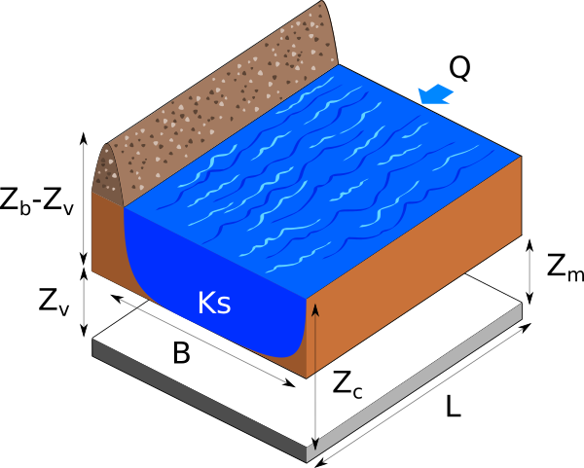
OpenTURNS demonstration of reliability methods: The flood model
Failure: river level > dyke height
4 independent random variables
4 deterministic parameters
https://openturns.github.io/openturns/latest/usecases/use_case_flood_model.html#use-case-flood-model

Slide 10


Funding scheme
This project has received funding from the European Union’s Horizon 2020 Research and Innovation Programme under Grant Agreement No. 101006689
Project Coordinator
Nikolay Krasimirov Dimitrov
DTU Wind and Energy Systems
nkdi@dtu.dk

